Slide 1
Decision Tree Learning
Learning Decision Trees
  Decision tree induction is a simple but powerful learning paradigm. In this method a set of training examples is broken down into smaller and smaller subsets while at the same time an associated decision tree get incrementally developed. At the end of the learning process, a decision tree covering the training set is returned.
  The decision tree can be thought of as a set sentences (in Disjunctive Normal Form) written propositional logic.
  Some characteristics of problems that are well suited to Decision Tree Learning are:
    Attribute-value paired elements
    Discrete target function
    Disjunctive descriptions (of target function)
    Works well with missing or erroneous training data

Slide 2
Decision Tree Learning for PlayTennis
Outlook
Sunny
Overcast
Rain
Humidity
Yes
Wind
High
Normal
Strong
Weak
No
Yes
No
Yes
1

Slide 3
Decision Tree Learning
Day
Outlook
Temperature
Humidity
Wind
PlayTennis
D1
Sunny
Hot
High
Weak
No
D2
Sunny
Hot
High
Strong
No
D3
Overcast
Hot
High
Weak
Yes
D4
Rain
Mild
High
Weak
Yes
D5
Rain
Cool
Normal
Weak
Yes
D6
Rain
Cool
Normal
Strong
No
D7
Overcast
Cool
Normal
Strong
Yes
D8
Sunny
Mild
High
Weak
No
D9
Sunny
Cool
Normal
Weak
Yes
D10
Rain
Mild
Normal
Weak
Yes
D11
Sunny
Mild
Normal
Strong
Yes
D12
Overcast
Mild
High
Strong
Yes
D13
Overcast
Hot
Normal
Weak
Yes
D14
Rain
Mild
High
Strong
No

Slide 4
Decision Tree
Decision trees represent a disjunction of conjunctions of constraints on the attribute values of instances.
Each path from the tree root to a leaf corresponds to a conjunction of attribute tests, and
The tree itself is a disjunction of these conjunctions.
Each node represents a feature and each link represents a decision
Each leaf node represents an outcome
(Outlook = Sunny ∧ Humidity = Normal)
(Outlook = Overcast)
(Outlook = Rain ∧ Wind = Weak)
Outlook
Sunny
Overcast
Rain
Humidity
Yes
Wind
High
Normal
Strong
Weak
No
Yes
No
Yes

Slide 5
Decision Tree
Decision trees classify instances by sorting them down the tree from the root to some leaf node, which provides the classification of the instance.
Each node in the tree specifies a test of some attribute of the instance.
Each branch descending from a node corresponds to one of the possible values for the attribute.
Each leaf node assigns a classification.
The instance
(Outlook=Sunny, Temperature=Hot, Humidity=High, Wind=Strong)
  is classified as a negative instance.

Slide 6
Decision Tree Learning
Building a Decision Tree
  First test all attributes and select the one that would function as the best root;
  Break-up the training set into subsets based on the branches of the root node;
  Test the remaining attributes to see which ones fit best underneath the branches of the root node;
  Continue this process for all other branches until
    all examples of a subset are of one type
    there are no examples left (return majority classification of the parent)
    there are no more attributes left (default value should be majority classification)

Slide 7
When to Consider Decision Trees
Instances are represented by attribute-value pairs.
  Fixed set of attributes, and the attributes take a small number of disjoint possible values.
The target function has discrete output values.
  Decision tree learning is appropriate for a boolean classification, but it easily extends to learning functions with more than two possible output values.
Disjunctive descriptions may be required.
  decision trees naturally represent disjunctive expressions.
The training data may contain errors.
  Decision tree learning methods are robust to errors, both errors in classifications of the training examples and errors in the attribute values that describe these examples.
The training data may contain missing attribute values.
  Decision tree methods can be used even when some training examples have unknown values.
Decision tree learning has been applied to problems such as learning to classify
  medical patients by their disease,
  equipment malfunctions by their cause, and
  loan applicants by their likelihood of defaulting on payments.

Slide 8
Which Attribute is ”best”?
We would like to select the attribute that is most useful for classifying examples.
Informution gain measures how well a given attribute separates the training examples according to their target classification.
ID3 uses this information gain measure to select among the candidate attributes at each step while growing the tree.
In order to define information gain precisely, we use a measure commonly used in information theory, called entropy
Entropy characterizes the (im)purity of an arbitrary collection of examples. It gives the amount of uncertainty in dataset.

Slide 9
Which Attribute is ”best”?
[29+,35-]
A₁=?
A₂=?
[29+,35-]
True
False
True
False
[21+, 5-]
[8+, 30-]
[18+, 33-]
[11+, 2-]

Slide 10
Entropy
Given a collection S, containing positive and negative examples of some target concept, the entropy of S relative to this boolean classification is:
  Entropy(S) = -p/(p+n)log₂(p/(p+n))- n/(p+n)log₂ (n/(p+n))
S is a sample of training examples
p is the proportion of positive examples
n is the proportion of negative examples

Slide 11
Entropy
Entropy([9+,5-] = – (9/14) log₂(9/14) – (5/14) log₂(5/14) = 0.940
Entropy([12+,4-] = – (12/16) log₂(12/16) – (4/16) log₂(4/16) = 0.811
Entropy([12+,5-] = – (12/17) log₂(12/17) – (5/17) log₂(5/17) = 0.874
Entropy([8+,8-] = – (8/16) log₂(8/16) – (8/16) log₂(8/16) = 1.0
Entropy([8+,0-] = – (8/8) log₂(8/8) – (0/8) log₂(0/8) = 0.0
Entropy([0+,8-] = – (0/8) log₂(0/8) - (8/8) log₂(8/8) = 0.0
It is assumed that log₂(0) is 0

Slide 12
Calculate Average Information Entropy
c
∑
I(attribute) = (p_{i}+ n_{i} )/(p+n) Entropy(A)
i=1

Slide 13
Information Gain
Entropy is a measure of the impurity in a collection of training examples
Information gain is a measure of the effectiveness of an attribute in classifying the training data.
Information gain measures the expected reduction in entropy by partitioning the examples according to an attribute( Difference in Entropy before and after splitting dataset on attribute A)
Gain(S,A) = Entropy(S)- I(attribute)
S – a collection of examples

Slide 14
Which attribute is the best classifier?
S: [29+,35-] Attributes: A and B
possible values for A: a,b possible values for B: c,d
Entropy([29+,35-]) = -29/64 log₂ 29/64 – 35/64 log₂ 35/64 = 0.99
A?
B?
a
b
c
d
[21+, 5-]
[8+, 30-]
[18+, 33-]
[11+, 2-]

Slide 15
Which attribute is the best classifier?
E([29+,35-]) = 0.99
E([29+,35-]) = 0.99
A?
B?
a
b
c
d
[21+, 5-]
[8+, 30-]
[18+, 33-]
[11+, 2-]
E([21+,5-]) = 0.71
E([8+,30-]) = 0.74
E([18+,33-]) = 0.94
E([11+,2-]) = 0.62
Gain(S,A) = Entropy(S)
-26/64*Entropy([21+,5-])
-38/64*Entropy([8+,30-])
= 0.27
Gain(S,B) = Entropy(S)
-51/64*Entropy([18+,33-])
-13/64*Entropy([11+,2-])
= 0.12
A provides greater information gain than B.
A is a better classifier than B.
Introduction to Machine Learning

Slide 16
ID3 - Training Examples – [9+,5-]
Day | Outlook | Temp. | Humidity | Wind | Play Tennis
D1 | Sunny | Hot | High | Weak | No
D2 | Sunny | Hot | High | Strong | No
D3 | Overcast | Hot | High | Weak | Yes
D4 | Rain | Mild | High | Weak | Yes
D5 | Rain | Cool | Normal | Weak | Yes
D6 | Rain | Cool | Normal | Strong | No
D7 | Overcast | Cool | Normal | Weak | Yes
D8 | Sunny | Mild | High | Weak | No
D9 | Sunny | Cold | Normal | Weak | Yes
D10 | Rain | Mild | Normal | Strong | Yes
D11 | Sunny | Mild | Normal | Strong | Yes
D12 | Overcast | Mild | High | Strong | Yes
D13 | Overcast | Hot | Normal | Weak | Yes
D14 | Rain | Mild | High | Strong | No
Introduction to Machine Learning

Slide 17
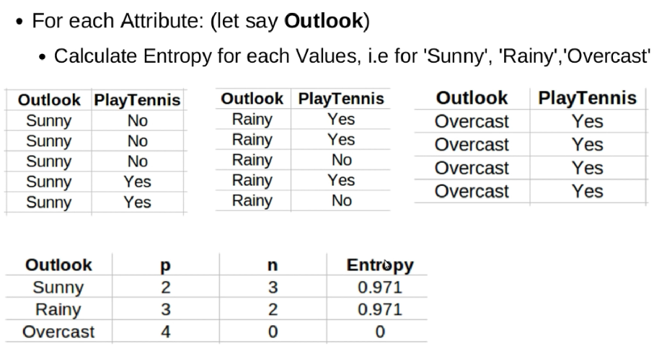
Calculate the Entropy for the entire data set
Entropy([9+,5-] = – (9/14) log₂(9/14) – (5/14) log₂(5/14) = 0.940

Slide 18
ID3 – Selecting Next Attribute
S=[9+,5-]
E=0.940
Outlook
Sunny
Overcast
Rain
[2+, 3-]
[4+, 0]
[3+, 2-]
Entropy of Outlook = Sunny
Entropy of Outlook = Overcast
E=0.971
E=0.0
E=0.971
Gain(S,Outlook) =
0.940-(5/14)*0.971 -(4/14)*0.0 -(5/14)*0.971
= 0.247
Entropy of Outlook = Rain

Slide 19
Calculate Average Information Entropy
I(outlook) = (Psunny + Nsunny)/(p+n) (Entropy (outlook = sunny)) +
(Povercast + Novercast)/(p+n) (Entropy (outlook = overcast)+
(Prainy + Nrainy)/(p+n) (Entropy (outlook = rainy))
I(outlook) = (2+3)/(9+5) * 0.971 + (4+0)/((9+5) *0 +
(3+2)/(9+5) * 0.971
Gain(S,Outlook) = 0.940-(5/14)*0.971 -(4/14)*0.0 -(5/14)*0.971 (avg.info.Entropy)
= 0.247

Slide 20
ID3 – Selecting Next Attribute
Entropy([9+,5-] = – (9/14) log₂(9/14) – (5/14) log₂(5/14) = 0.940
S=[9+,5-]
E=0.940
S=[9+,5-]
E=0.940
Humidity
Wind
High
Normal
Weak
Strong
[3+, 4-]
[6+, 1-]
[6+, 2-]
[3+, 3-]
E=0.592
E=0.985
Gain(S,Humidity) =
0.940-(7/14)*0.985-(7/14)*0.592
= 0.151
Gain(S,Wind) =
0.940-(8/14)*0.811-(6/14)*1.0
= 0.048

Slide 21
ID3 – Selecting Next Attribute
S=[9+,5-]
E=0.940
Temp.
Hot
Mild
Cold
[2+, 2-]
[4+, 2-]
[3+, 1-]
E=1.0
E= 0.911
E=0.811
Gain(S,Temperature) =
0.940-(4/14)*1.0 - (6/14)*0.911 - (4/14)*0.811
= 0.029
Introduction to Machine Learning

Slide 22
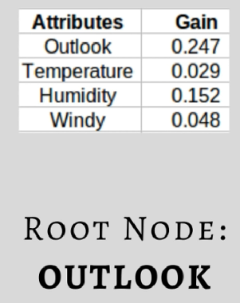
Pick the highest gain attribute

Slide 23
Best Attribute - Outlook
S=[9+,5-]
S={D1,D2,…,D14}
Outlook
Sunny
Overcast
Rain
[2+, 3-]
[4+, 0]
[3+, 2-]
S_{sunny}={D1,D2,D8,D9,D11}
S_{overcast}={D3,D7,D12,D13}
S_{rain}={D4,D5,D6,D10,D14}
?
Yes
?
Which attribute should be tested here?
Introduction to Machine Learning

Slide 24
Repeat the same thing for the sub-trees till we get the tree
Outlook | Temp | Humidity | Windy | Play Tennis
Sunny | Hot | High | Weak | No
Sunny | Hot | High | Strong | No
Sunny | Mild | High | Weak | No
Sunny | Cool | Normal | Weak | Yes
Sunny | Mild | Normal | Strong | Yes
When Outlook = Sunny
p= 2 and n=3
Entropy(Sunny) = -2/(2+3) log₂(2/(2+3)) – 3/(2+3)log₂(3/(2+3))
= 0.970

Slide 25
Calculate the entropy value for Humidity
Outlook | Humidity | Play Tennis
Sunny | High | No
Sunny | High | No
Sunny | High | No
Sunny | Normal | Yes
Sunny | Normal | Yes
Humidity | p | n | Entropy
High | 0 | 3 | 0
Normal | 2 | 0 | 0
Gain(S_{sunny} , Humidity) = 0.970-(3/5)0.0 – 2/5(0.0) = 0.970

Slide 26
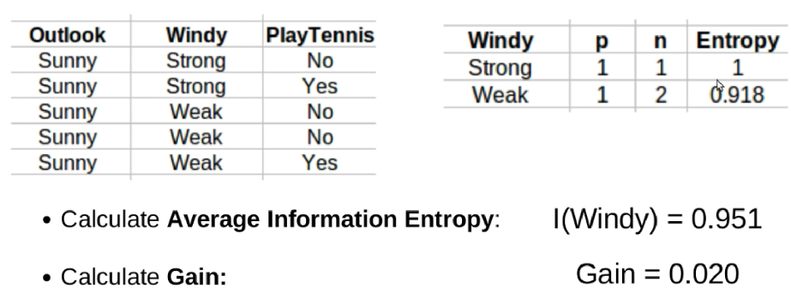
Calculate the entropy value for each Windy
Gain(S_{sunny} , Wind) = 0.970 -(2/5)1.0 – 3/5(0.918) = 0.019

Slide 27
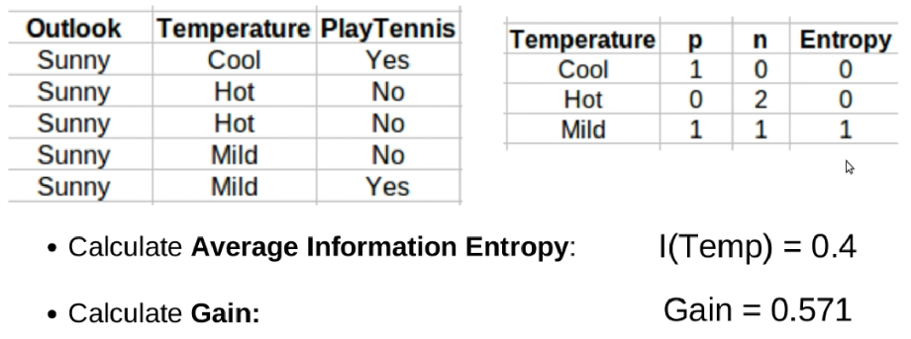
Calculate the entropy value for Temperature
Gain(S_{sunny} , Temp.) = 0.970-(2/5)0.0 –2/5(1.0)-(1/5)0.0 = 0.570

Slide 28
ID3 - S_{sunny}
So, Hummudity will be selected

Slide 29
Repeat the same thing for the sub-trees till we get the tree
Outlook | Temp | Humidity | Windy | Play Tennis
Rain | Mild | High | Weak | Yes
Rain | Cool | Normal | Weak | Yes
Rain | Cool | Normal | Strong | No
Rain | Mild | Normal | Weak | Yes
Rain | Mild | High | Strong | No
When Outlook = Rain
p= 3 and n=2
Entropy(Rain) = -3/(3+2) log₂(3/(3+2)) – 2/(3+2)log₂(2/(3+2))
= 0.971

Slide 30
Outlook | Humidity | Play Tennis
Rain | High | Yes
Rain | High | No
Rain | Normal | Yes
Rain | Normal | No
Rain | Normal | Yes
Humidity | p | n | Entropy
High | 1 | 1 | 0
Normal | 2 | 1 | 0
Average Information Entropy I(Humidity)
Gain(S_{rain} , Humidity) = Entropy(S_{rain}) – (I_{humidity})
= 0.971- 0.951= 0.020

Slide 31
ID3 - S_{rainy}
Gain(S_{rain} , Temp.) = Entropy(S_{rain}) – (I_{temperature})
= 0.971- 0.951= 0.020
Gain(S_{rain} , Wind) = Entropy(S_{rain}) – (I_{windy})
= 0.971- 0 = 0.971
So, Wind will be selected

Slide 32
ID3 - Result
Outlook
Sunny
Overcast
Rain
Humidity
Yes
Wind
[D3,D7,D12,D13]
High
Normal
Strong
Weak
No
Yes
No
Yes
[D1,D2]
[D8,D9,D11]
[D6,D14]
[D4,D5,D10]
Introduction to Machine Learning

Slide 33
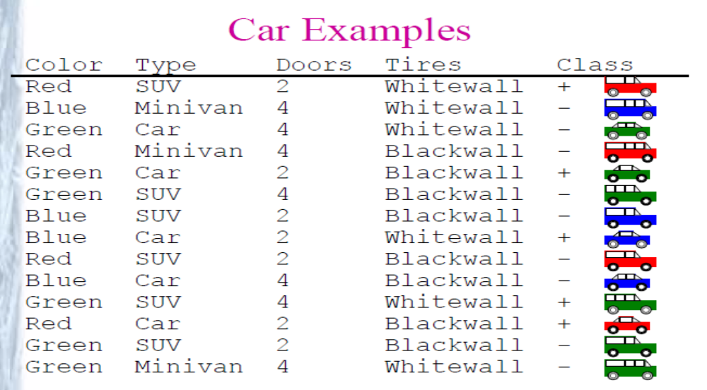
Problem-1

Slide 34
ID3 - Algorithm
ID3(Examples, TargetAttribute, Attributes)
Create a Root node for the tree
If all Examples are positive, Return the single-node tree Root, with label = +
If all Examples are negative, Return the single-node tree Root, with label = -
If Attributes is empty, Return the single-node tree Root, with label = most common value of TargetAttribute in Examples
Otherwise Begin
  A ← the attribute from Attributes that best classifies Examples
  The decision attribute for Root ←A
  For each possible value, vi, of A,
    Add a new tree branch below Root, corresponding to the test A = vi
    Let Examples_{vi} be the subset of Examples that have value vi for A
    If Examples_{vi} is empty
      Then below this new branch add a leaf node with label = most common
      value of TargetAttribute in Examples
      Else below this new branch add the subtree
      ID3(Examples_{vi} , TargetAttribute, Attributes – {A})
End
Return Root
Introduction to Machine Learning

Slide 35
Hypothesis Space Search in
Decision Tree Learning (ID3)
The hypothesis space searched by ID3 is the set of possible decision trees.
ID3 performs a simple-to complex, hill-climbing search through this hypothesis space,
Begins with the empty tree, then considers progressively more elaborate hypotheses in search of a decision tree that correctly classifies the training data.
The information gain measure guides the hill-climbing search.
Introduction to Machine Learning

Slide 36
Hypothesis Space Search in
Decision Tree Learning (ID3)
+ - +
A1
A2
+ - +
- - +
+ - +
-
A2
A2
-
-
A3
A4
Introduction to Machine Learning

Slide 37
ID3 - Capabilities and Limitations
ID3’s hypothesis space of all decision trees is a complete space of finite discrete-valued functions.
  Every finite discrete-valued function can be represented by some decision tree.
  Target function is surely in the hypothesis space.
ID3 maintains only a single current hypothesis, and outputs only a single hypothesis.
  ID3 loses the capabilities that follow from explicitly representing all consistent hypotheses.
  ID3 cannot determine how many alternative decision trees are consistent with the available training data.
No backtracking on selected attributes (greedy search)
  Local minimal (suboptimal splits)
Statistically-based search choices
  Robust to noisy data
Introduction to Machine Learning

Slide 38
Inductive Bias in ID3
ID3 search strategy
  selects in favor of shorter trees over longer ones,
  selects trees that place the attributes with highest information gain closest to the root.
  because ID3 uses the information gain heuristic and a hill climbing strategy, it does not always find the shortest consistent tree, and it is biased to favor trees that place attributes with high information gain closest to the root.
Inductive Bias of ID3:
  Shorter trees are preferred over longer trees.
  Trees that place high information gain attributes close to the root are preferred over those that do not.
Introduction to Machine Learning

Slide 39
Inductive Bias in ID3 - Occam’s Razor
OCCAM'S RAZOR: Prefer the simplest hypothesis that fits the data.
Why prefer short hypotheses?
Argument in favor:
  Fewer short hypotheses than long hypotheses
  A short hypothesis that fits the data is unlikely to be a coincidence
  A long hypothesis that fits the data might be a coincidence
Argument opposed:
  There are many ways to define small sets of hypotheses
  What is so special about small sets based on size of hypothesis
Introduction to Machine Learning

Slide 40
Inductive Bias in ID3 –
Restriction Bias and Preference Bias
ID3 searches a complete hypothesis space
  It searches incompletely through this space, from simple to complex hypotheses, until its termination condition is met
  Its inductive bias is solely a consequence of the ordering of hypotheses by its search strategy.
  Its hypothesis space introduces no additional bias.
Candidate Elimanation searches an incomplete hypothesis space
  It searches this space completely, finding every hypothesis consistent with the training data.
  Its inductive bias is solely a consequence of the expressive power of its hypothesis representation.
  Its search strategy introduces no additional bias.
Introduction to Machine Learning

Slide 41
Inductive Bias in ID3 –
Restriction Bias and Preference Bias
The inductive bias of ID3 is a preference for certain hypotheses over others, with no hard restriction on the hypotheses that can be eventually enumerated.
➔ preference bias ( search bias ).
The inductive bias of Candidate Elimination is in the form of a categorical restriction on the set of hypotheses considered.
➔ restriction bias ( language bias )
A preference bias is more desirable than a restriction bias, because it allows the learner to work within a complete hypothesis space that is assured to contain the unknown target function.
Introduction to Machine Learning

Slide 42
Overfitting
Given a hypothesis space H, a hypothesis h∈H is said to OVERFIT the training data if there exists some alternative hypothesis h'∈H, such that h has smaller error than h' over the training examples, but h' has a smaller error than h over the entire distribution of instances.
Reasons for overfitting:
  Errors and noise in training examples
  Coincidental regularities (especially small number of examples are associated with leaf nodes).
Introduction to Machine Learning

Slide 43
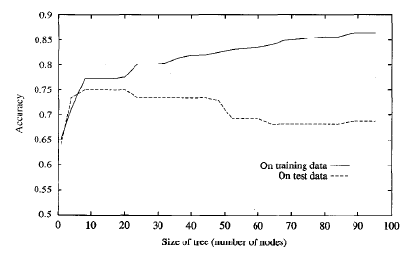
Overfitting
As ID3 adds new nodes to grow the decision tree, the accuracy of the tree measured
over the training examples increases monotonically.
However, when measured over a set of test examples independent of the training
examples, accuracy first increases, then decreases.
Introduction to Machine Learning

Slide 44
Avoid Overfitting
How can we avoid overfitting?
  Stop growing when data split not statistically significant
    stop growing the tree earlier, before it reaches the point where it perfectly classifies the training data
  Grow full tree then post-prune
    allow the tree to overfit the data, and then post-prune the tree.
The correct tree size is found by stopping early or by post-pruning, a key question is what criterion is to be used to determine the correct final tree size.
  Use a separate set of examples, distinct from the training examples, to evaluate the utility of post-pruning nodes from the tree.
  Use all the available data for training, but apply a statistical test to estimate whether expanding a particular node is likely to produce an improvement beyond the training set. ( chi-square test )
Introduction to Machine Learning

Slide 45
Avoid Overfitting - Reduced-Error Pruning
Split data into training and validation set
Do until further pruning is harmful:
  Evaluate impact on validation set of pruning each possible node (plus those below it)
  Greedily remove the one that most improves the validation set accuracy
Pruning of nodes continues until further pruning is harmful (i.e., decreases accuracy of the tree over the validation set).
Using a separate set of data to guide pruning is an effective approach provided a large amount of data is available.
  The major drawback of this approach is that when data is limited, withholding part of it for the validation set reduces even further the number of examples available for training.
Introduction to Machine Learning

Slide 46
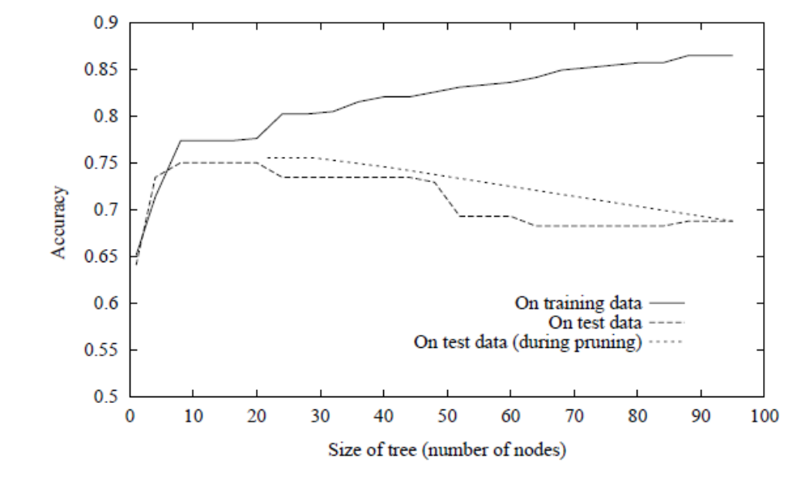
Effect of Reduced Error Pruning
the accuracy increases over the test set as nodes are pruned from the tree.
the validation set used for pruning is distinct from both the training and test sets.

Slide 47
Rule-Post Pruning
Rule-Post Prunning is another sucessful method for finding high accuracy hypotheses.
It is used by C4.5 learning algorithm (an extension of ID3).
Steps of Rule-Post Pruning:
  Infer the decision tree from the training set.
  Convert the learned tree into an equivalent set of rules by creating one rule for each path from the root node to a leaf node.
  Prune (generalize) each rule by removing any preconditions that result in improving its estimated accuracy.
  Sort the pruned rules by their estimated accuracy, and consider them in this sequence when classifying subsequent instances.

Slide 48
Converting a Decision Tree to Rules
Outlook
Sunny
Overcast
Rain
Humidity
Yes
Wind
High
Normal
Strong
Weak
No
Yes
No
Yes
R1: If (Outlook=Sunny) ∧ (Humidity=High) Then PlayTennis=No
R2: If (Outlook=Sunny) ∧ (Humidity=Normal) Then PlayTennis=Yes
R3: If (Outlook=Overcast) Then PlayTennis=Yes
R4: If (Outlook=Rain) ∧ (Wind=Strong) Then PlayTennis=No
R5: If (Outlook=Rain) ∧ (Wind=Weak) Then PlayTennis=Yes

Slide 49
Pruning Rules
Each rule is pruned by removing any antecedent (precondition).
  Ex. Prune R1 by removing (Outlook=Sunny) or (Humidity=High)
Select whichever of the pruning steps produced the greatest improvement in estimated rule accuracy.
  Then, continue with other preconditions.
  No pruning step is performed if it reduces the estimated rule accuracy.
In order to estimate rule accuracy:
  use a validation set of examples disjoint from the training set
  evaluate performance based on the training set itself(using statistical techniques). C4.5 uses this approach.

Slide 50
Why Convert The Decision Tree To Rules Before Pruning?
Converting to rules improves readability.
  Rules are often easier for to understand.
Distinguishing different contexts in which a node is used
  separate pruning decision for each path
No difference for root/inner
  no bookkeeping on how to reorganize tree if root node is pruned

Slide 51
Continuous-Valued Attributes
ID3 is restricted to attributes that take on a discrete set of values.
Define new discrete valued attributes that partition the continuous attribute value into a discrete set of intervals
For a continuous-valued attribute A that is, create a new boolean attribute Ac, that is true if A < c and false otherwise.
  Select c using information gain
  Sort examples according to the continuous attributeA,
  Then identify adjacent examples that differ in their target classification
  Generate candidate thresholds midway between corresponding values of A.
  The value of c that maximizes information gain must always lie at a boundary.
  These candidate thresholds can then be evaluated by computing the information gain associated with each.

Slide 52
Continuous-Valued Attributes - Example
Temperature: 40 48 60 72 80 90
PlayTennis : No No Yes Yes Yes No
Two candidate thresholds: (48+60)/2=54 (80+90)/2=85
Check the information gain for new boolean attributes:
Temperature_{>54} Temperature_{>85}
Use these new new boolean attributes same as other discrete valued attributes.

Slide 53
Alternative Selection Measures
Information gain measure favors attributes with many values
  separates data into small subsets
  high gain, poor prediction
Ex. Date attribute has many values, and may separate training examples into very small subsets (even singleton sets – perfect partitions)
  Information gain will be very high for Date attribute.
  Perfect partition ➔maximum gain : Gain(S,Date) = Entropy(S) – 0 = Entropy(S) because log₂1 is 0.
  It has high information gain, but very poor predictor for unseen data.
There are alternative selection measures such as GainRatio measure based on SplitInformation

Slide 54
Split Information
The gain ratio measure penalizes attributes with many values (such as Date) by incorporating a term, called split informution
Split information for boolean attributes is 1 (= log₂2),
Split information fot attributes for n values is log₂n
SplitInformation term discourages the selection of attributes with many uniformly distributed values.
c
∑
SplitInformation(S,A) = - ( |Si| / |S| ) log₂ ( |Si| / |S| )
i=1
GainRatio(S,A) = Gain(S,A) / SplitInformation(S,A)

Slide 55
Practical Issues on Split Information
Some value ‘rules’
  |Si| close to |S|
  SplitInformation 0 or very small
  GainRatio undefined or very large
Apply heuristics to select attributes
  compute Gain first
  compute GainRatio only when Gain large enough (above average Gain)

Slide 56
Missing Attribute Values
The available data may be missing values for some attributes.
It is common to estimate the missing attribute value based on other examples for which this attribute has a known value.
Assume that an example (with classification c) in S has a missing value for attribute A.
  Assign the most common value of A in S.
  Assign the most common value of in the examples having c classification in S.
  Or, use probabilty value for each possibşe attribute value.

Slide 57
Attributes with Differing Costs
Measuring attribute costs something
  prefer cheap ones if possible
  use costly ones only if good gain
  introduce cost term in selection measure
  no guarantee in finding optimum, but give bias towards cheapest
Example applications
  robot & sonar: time required to position
  medical diagnosis: cost of a laboratory test

Slide 58
Main Points with Decision Tree Learning
Decision tree learning provides a practical method for concept learning and for learning other discrete-valued functions.
  decision trees are inferred by growing them from the root downward, greedily selecting the next best attribute.
ID3 searches a complete hypothesis space.
The inductive bias in ID3 includes a preference for smaller trees.
Overfitting training data is an important issue in decision tree learning.
  Pruning decision trees or rules are important.
A large variety of extensions to the basic ID3 algorithm has been developed. These extensions include methods for
  post-pruning trees, handling real-valued attributes, accommodating training examples with missing attribute values, using attribute selection measures other than information gain, and considering costs associated with instance attributes.

